Slide 1
Engineer in Test:
Bridging the Gap
Dmitry Vinnik, @DmitryVinnik
Lead Software Engineer, Salesforce

Slide 2
We have a Problem

Slide 3
Gap within Teams
Gap within Teams
Engineers
Testers
Stakeholders

Slide 4
Our Goal Today?

Slide 5
Bridge that Gap

Slide 6
Gap within Teams
Bridging the Gap
Engineers
Testers
Stakeholders

Slide 7
Today’s Focus
Today’s Focus
Quality vs Quantity
Union of Engineering and Testing
Importance of Responsibility for Quality
Notes:
Will talk about life
About Ice Cream

Slide 8
Agenda
Agenda
Quality vs Quantity
Back to Basics
Back to Basics
Team Dynamics
Team Dynamics
Notes:
With better foundation, easier to build the bridge

Slide 9
Where should we start?

Slide 10
Let’s talk about Life

Slide 11

Book Suggestion
Notes:
https://www.amazon.com/Natural-Causes-Epidemic-Certainty-Ourselves/dp/1455535915

Slide 12
“Medicine exists to transform people into raw material for a profit-hungry medical-industrial complex.”
by Barbara Ehrenreich
Notes:
North America notorious for prolonging life
Death Positive Society
No need for proactive medicine

Slide 13
Is it really all about Quantity?
Notes:
Is it really about how many years we have?

Slide 14
“We’ve added Years to Life,
not Life to Years”
by George Carlin
Notes:
Longevity is meaningless without quality of life

Slide 15
Conclusion:
Quality is what matters!

Slide 16
In Life

Slide 17
and

Slide 18
In Testing

Slide 19
But

Slide 20
Let’s play
Devil’s Advocate

Slide 21
Why prefer Quantity?

Slide 22
Code Coverage

Slide 23
Code Coverage:
Bad Reasons
Promotion Metrics
Quality Target
Notes:
Bad metrics for performance
Tests themselves have no value
It is a number of bugs/defects they catch
Trying to get to 100%?

Slide 24
AssertionFreeTesting
by Martin Fowler
https://goo.gl/7fnbUB
Notes:
Company was up for a bid
Every public method was tested
But, there were no assertions

Slide 25
Code Coverage:
Bad Reasons
Promotion Metrics
Quality Target
Marketing Value
Notes:
Trying to impress stakeholders -> not a good move
Look at Theranos for an example of PR over value

Slide 26
Still

Slide 27
What is a problem with Quantity?

Slide 28

Notes:
Can't see the forest for the trees
Need to move from
Too many incorrect tests
Missed valid cases
Overworked testers (remember staying late)
Reference: https://www.pexels.com/photo/green-trees-113338/

Slide 29
What is Code Coverage
good for?

Slide 30
Finding Untested Code

Slide 31
Your Goal should be

Slide 32

Notes:
Goldilocks testing suites - just enough
Towards
Fewer tests but to the point
Rest
Valid issues are uncovered
Reference:
https://www.amazon.com/Goldilocks-Three-Bears-Parragon-Books/dp/1445477947

Slide 33
Conclusion:

Slide 34
Once again

Slide 35
Quality over Quantity

Slide 36
Now

Slide 37
We have our
priorities straight

Slide 38
How do we improve?

Slide 39
Back to the basics

Slide 40
Agenda
Quality vs. Quantity
Quality vs Quantity
Back to Basics
Back to Basics
Back to Basics
Team Dynamics
Team Dynamics

Slide 41
What are
our Test Basics?

Slide 42
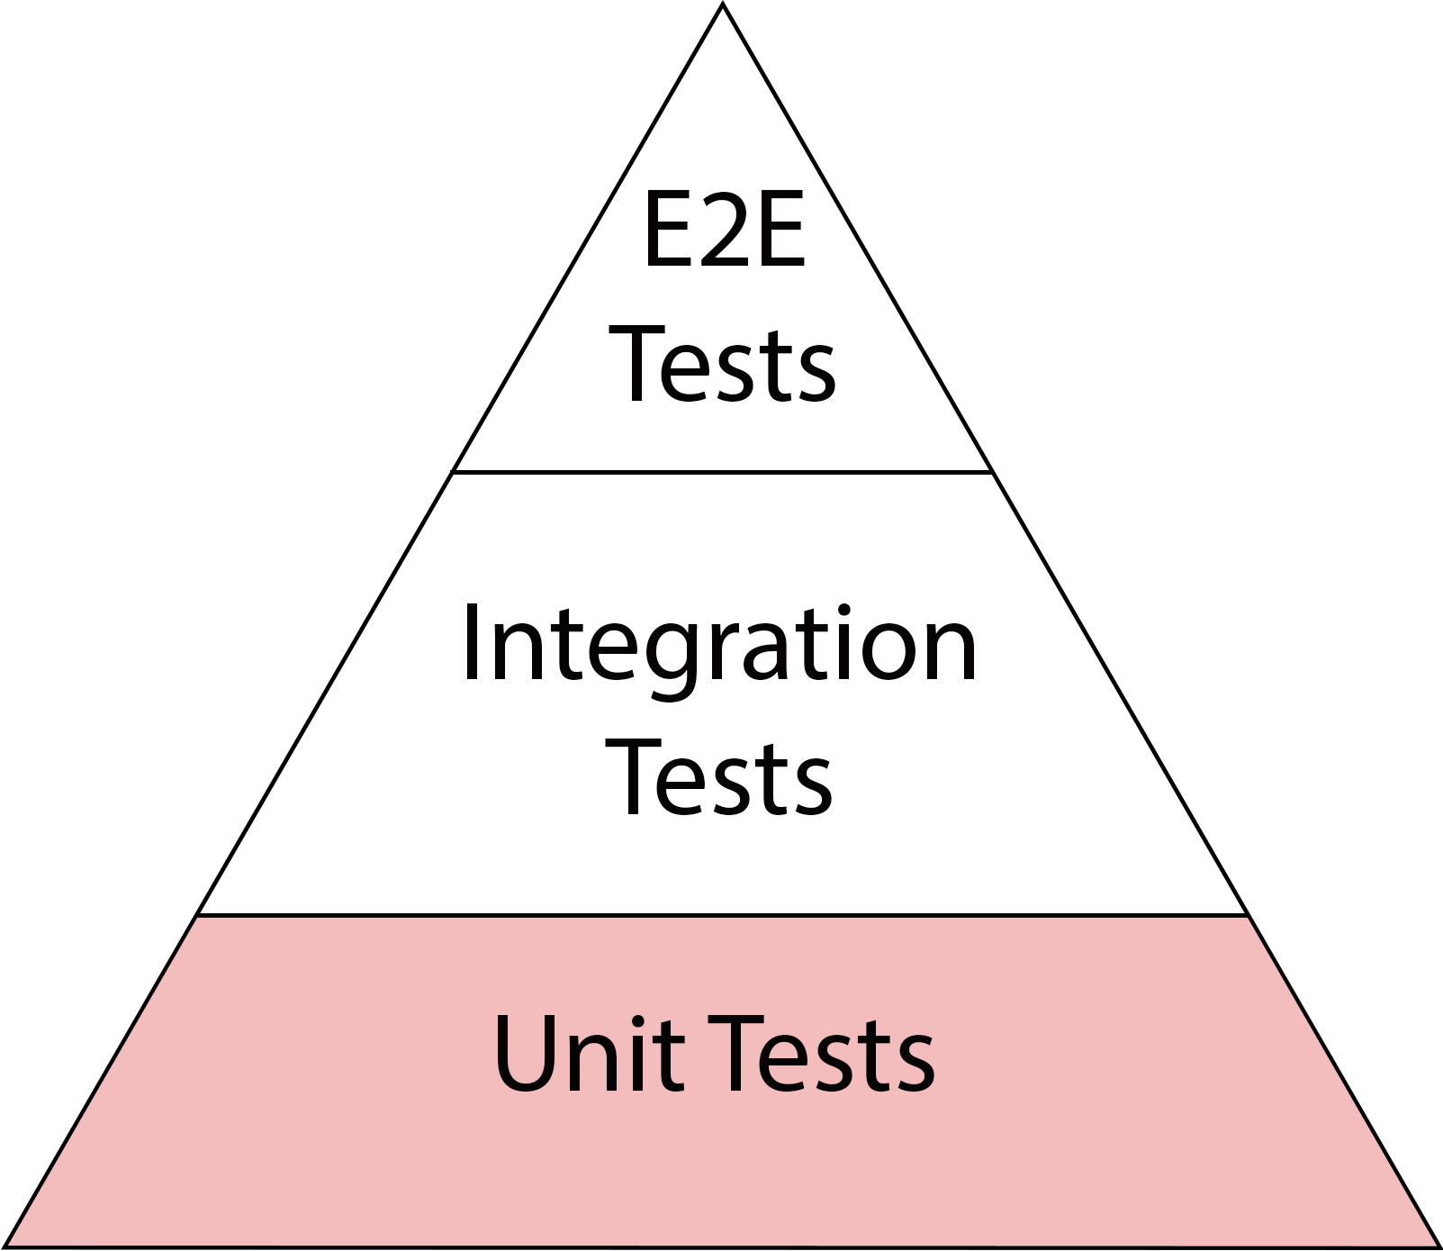
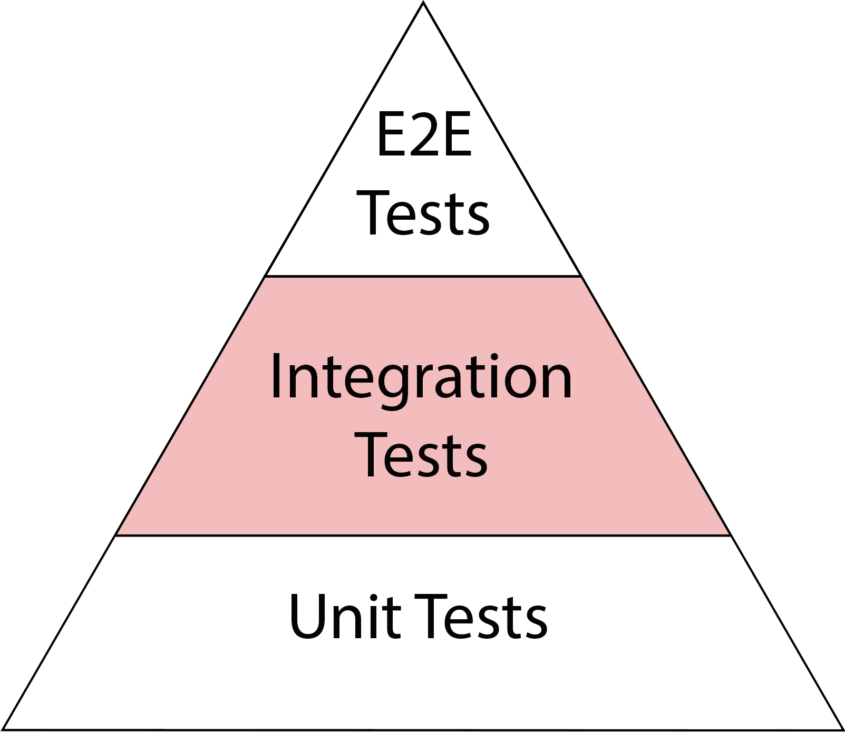
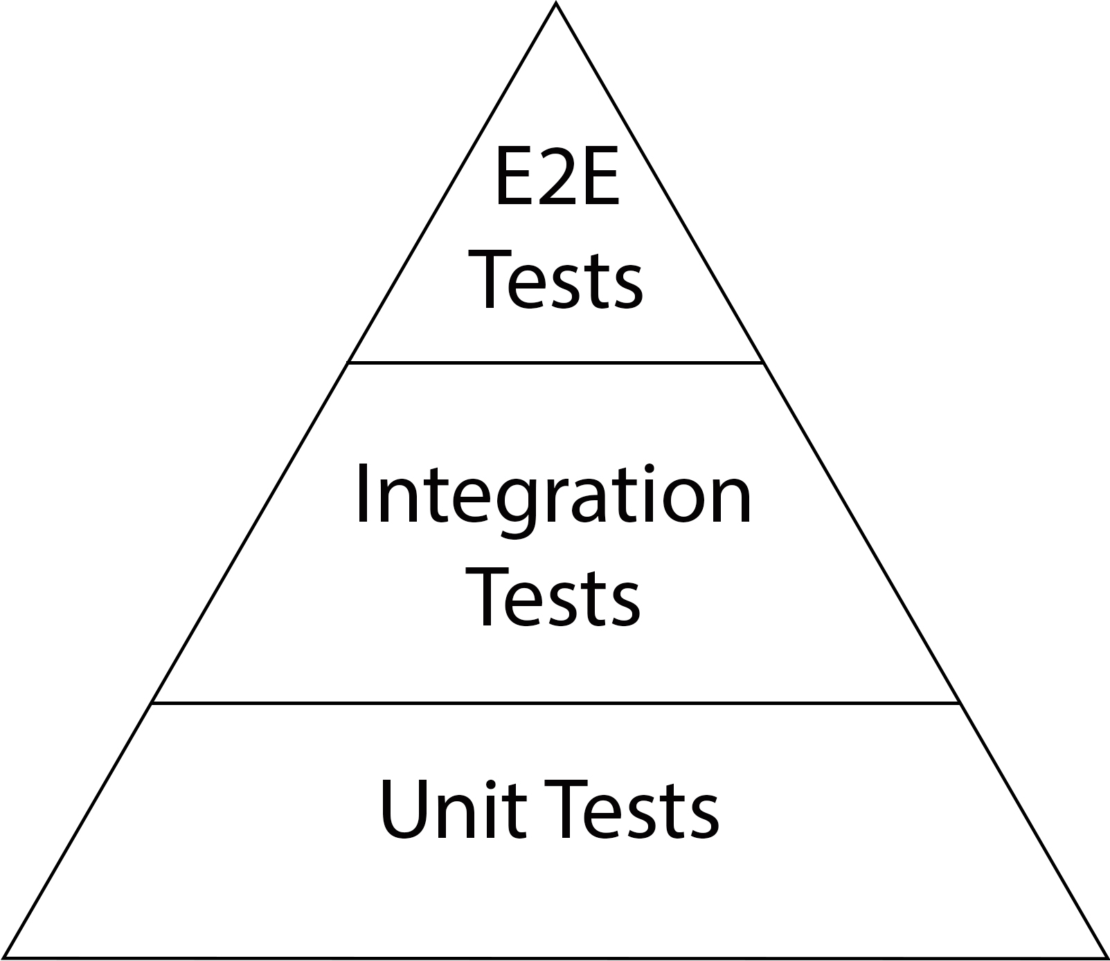
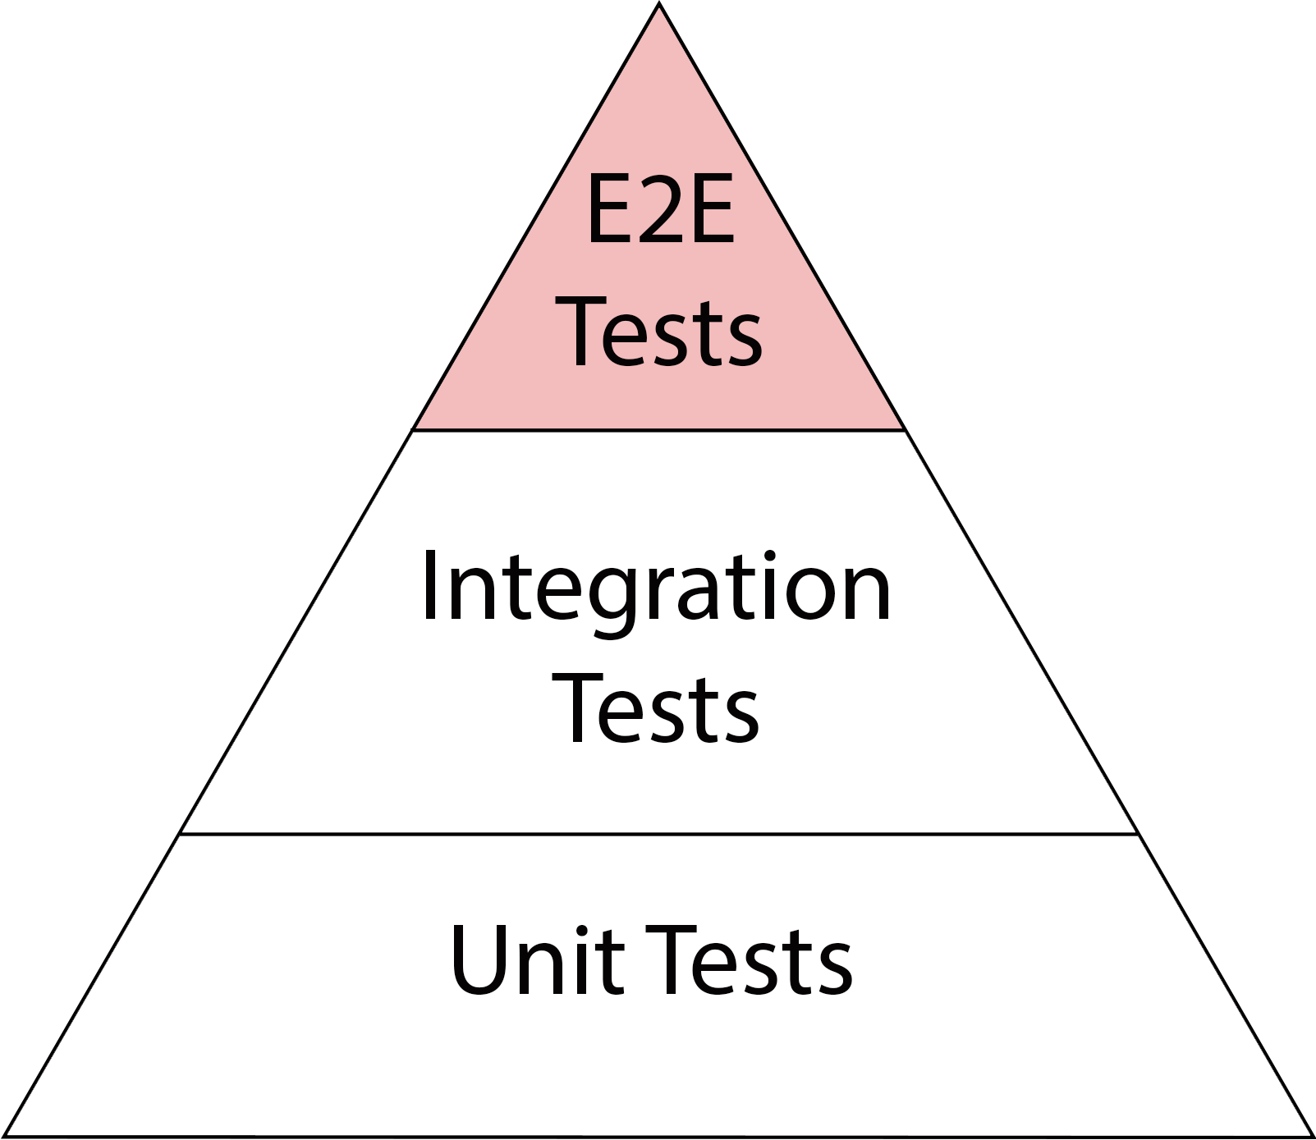
Test Pyramid
↑ Fidelity
↓ Speed
↑ Cost
↓ Fidelity
↑ Speed
↓ Cost
Notes:
Explain width is #tests

Slide 43
Simple, right?

Slide 44
Easier said than done

Slide 45
Real life

Slide 46
Real life
is more Real

Slide 47
Real “Test Pyramids”
Ice Cream Cone
Hourglass
Hourglass
Cupcake
Cupcake
Notes:
Getting hungry with these examples
Looking and fixing real problems

Slide 48
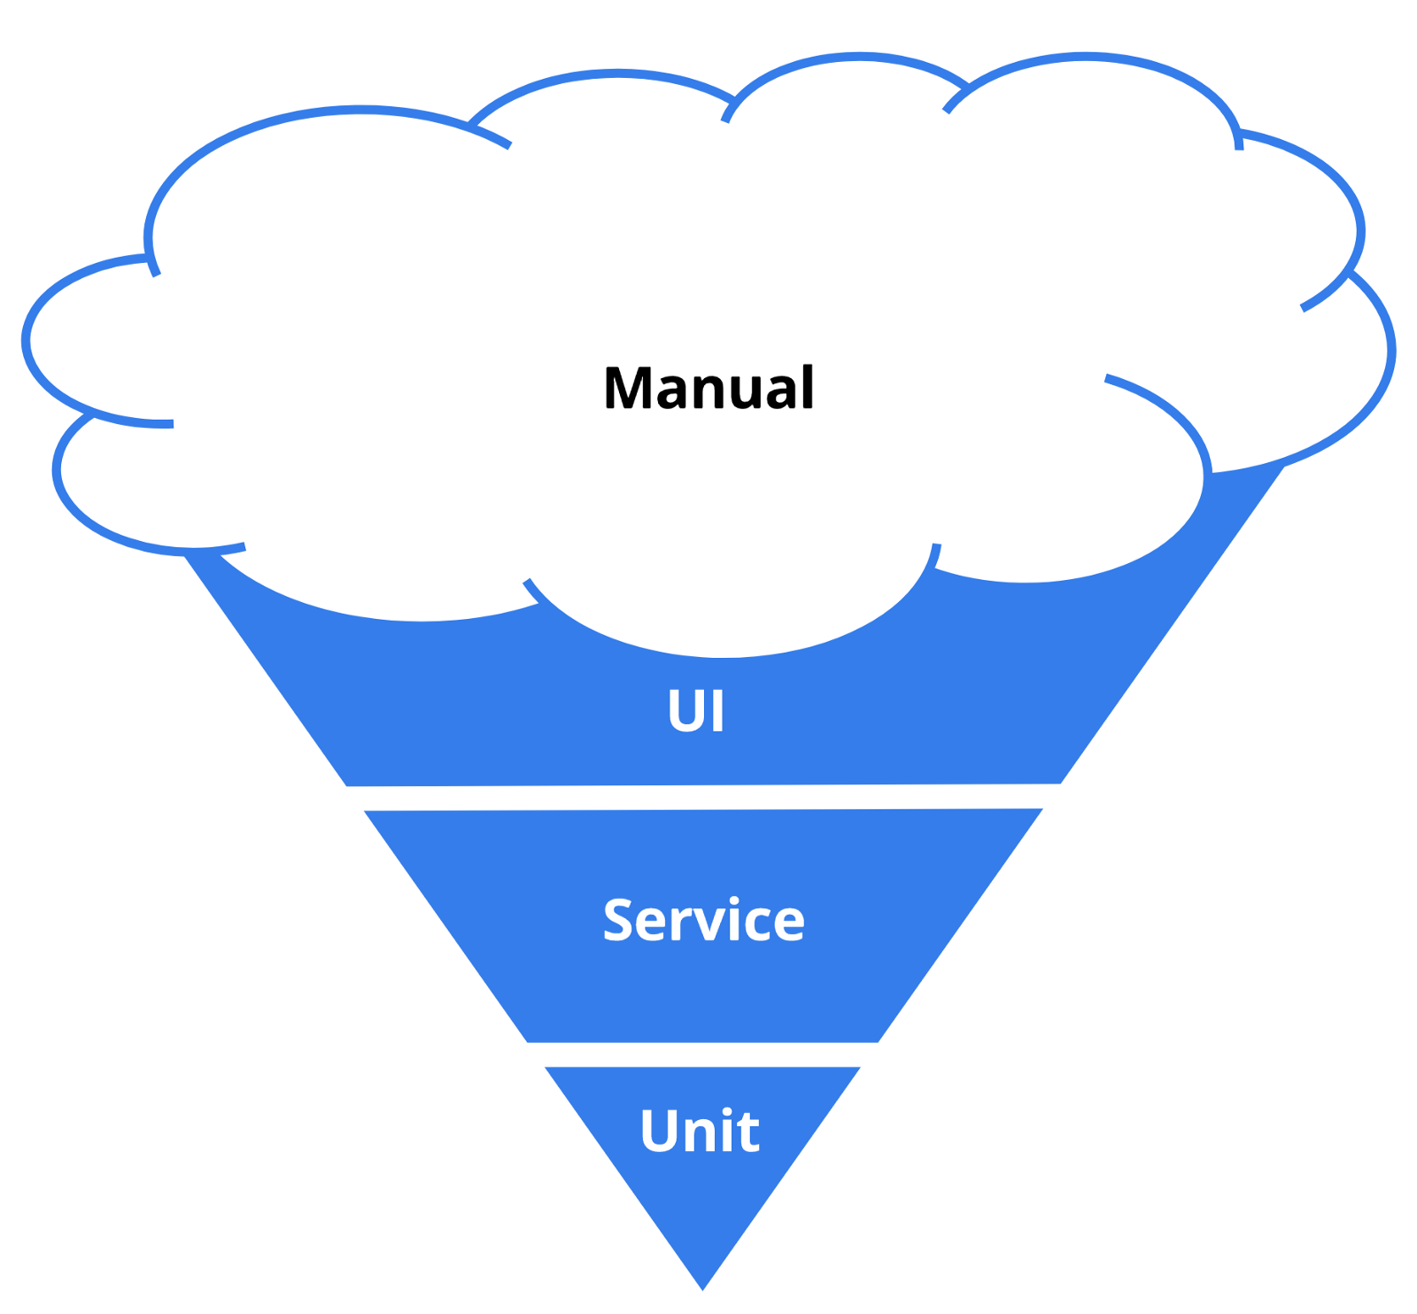
By Tim Cochran
Notes:
Describe each step
Reference: https://medium.com/@timothy.cochran/test-pyramid-the-key-to-good-automated-test-strategy-9f3d7e3c02d5

Slide 49
What is a Problem?
Notes:
Who doesn’t like ice cream?

Slide 50
Ice Cream Problems
Manual Testing
↑ UI Tests
↑ UI Tests
↓ Unit Tests
↓ Unit Tests
Notes:
Manual testing is a problem
especially because we have the most number of those tests
Disbalance of the pyramid
Problematic because of the aspects of every level: fidelity, cost and speed

Slide 51
Manual Testing is Important
Notes:
Who doesn’t like ice cream?

Slide 52
Manual Testing:
Importance
Exploratory Testing
Usability Testing
Canary Testing
Notes:
There is a time and place and we will talk about

Slide 53

Book Suggestion
Notes:
Book Link: https://www.amazon.ca/Explore-Increase-Confidence-Exploratory-Testing/dp/1937785025

Slide 54
But

Slide 55
Manual Testing

Slide 56
Manual Testing
Cannot be Core Testing

Slide 57
Why?

Slide 58
Continuous Delivery
Notes:
One of the reasons

Slide 59
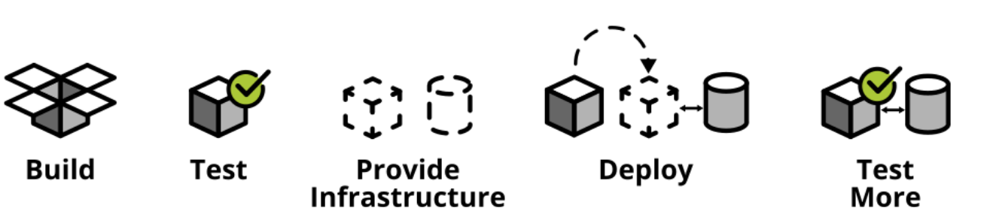
Continuous Delivery
By Ham Vocke
Notes:
Rate of changes is increasing
Need to keep up development
Need to keep up testing
Reference: https://martinfowler.com/articles/practical-test-pyramid.html

Slide 60
Bridging the Gap: Engineers and Testers
Notes:
Want to empower Testers
Improve self-esteem

Slide 61
Continuous Delivery
By Ham Vocke
Notes:
Highlight the importance of testing
Reference: https://martinfowler.com/articles/practical-test-pyramid.html

Slide 62
Testing and
Continuous Deliver
Smoke Tests
Regression Funnel
Notes:
Place of Testing in CD
Importance of Feedback loop
Importance of Testing
Nobody can say - “it is just tests”
Smoke Test
Bare minimum for CD (scale matters), usually no UI
Regression Tests Funnel
Separate, running longer tests
Problem with UI tests

Slide 63
Ice Cream Problems
Manual Testing
Manual Testing
↑ UI Tests
↑ UI Tests
↑ UI Tests
↓ Unit Tests
↓ Unit Tests
Notes:
Manual testing is a problem
especially because we have the most number of those tests
Disbalance of the pyramid
Problematic because of the aspects of every level: fidelity, cost and speed

Slide 64
Lots of UI tests

Slide 65
So what?

Slide 66
Remember the Pyramid

Slide 67
Remember the Pyramid:
UI Tests
↑ Fidelity
↓ Speed
↑ Cost
Notes:
Fidelity is good, but how many real customer use cases do you have?
If slow, where does it fit on CD pipeline?
Who would maintain it?

Slide 68
Why so many UI tests?
Test Duplication
“Cheap” Investment
“Cheap” Investment
Sunk Cost
Fallacy
Sunk Cost
Fallacy
Decomposition Fallacy
Decomposition Fallacy
Notes:
Duplication
Especially on between layers
Cheap Investment fallacy
“Testing a whole system is cheaper than testing its constituent parts”
Same people who like to throw a word “synergy” around
Sunk Cost Fallacy
Cost that has already been incurred and cannot be recovered
Keeping tests around cuz already spend time on them - simply delete them
Decomposition fallacy
“Testing whole system is not the same as testing its parts”

Slide 69
Bridging the Gap: Engineers and Testers

Slide 70
Test Duplication: Solutions
Test Reviews/
Test Retros
↓ Test Pyramid
DAMP
over DRY
Rule of Three and SRP
Notes:
Review tests
Especially if lots of failures
Test plan reviews
Steven King - Killing your Darlings
If anything fails, try to lower it on test pyramid
DAMP over in DRY in testing
Descriptive And Meaningful Phrases -> readability
Similar to Early Optimization

Slide 71
Why so many UI tests?
Test Duplication
Test Duplication
“Cheap” Investment
“Cheap” Investment
“Cheap” Investment
Sunk Cost
Fallacy
Sunk Cost
Fallacy
Sunk Cost
Fallacy
Decomposition Fallacy
Decomposition Fallacy
Decomposition Fallacy

Slide 72
Ultimately,
Priority Fallacies

Slide 73
Priority Fallacies
Ball Throwing
No Dev Ownership
Regression:
Future Problem
Notes:
Throwing a ball over the fence
“It is a testers’ job now”
It is a problem for future
Remember, cost of switching context between tasks is huge
Connected to the the last part - Team Dynamics

Slide 74
Bridging the Gap: Engineers and Testers

Slide 75
Testing

Slide 76
Testing is
Everyone’s Responsibility

Slide 77
Priority Fallacies:
Solutions
Recognize Problem
Handoff Standards
Test Code/
Prod Code
Notes:
Similar to AA - accept that there is a problem
Establish handoff standards
Developers
Initial set of basic tests
Create initial test plan
Testers
Approve
Edge cases
Testing as Production Code

Slide 78
Testing as
Production Code
Review Test Code
Test Champions
1:1
Model
Find Risky Areas
Notes:
Make sure Code Reviews are created (mentioned this previously)
Test Champions for code reviews
1 Story : 1 Test Suite
Test areas which can be risky - not getters

Slide 79

Book Suggestion
Notes:
Reference: https://www.amazon.com/Pragmatic-Programmer-Journeyman-Master/

Slide 80
Ice Cream Problems
Manual Testing
Manual Testing
↑ UI Tests
↑ UI Tests
↑ UI Tests
↑ UI Tests
↓ Unit Tests
↓ Unit Tests
↓ Unit Tests

Slide 81
What are Unit Tests?

Slide 82
Why are they important?
Notes:
What’s a problem to keep them a small number?

Slide 83
Unit Tests are

Slide 84
Feedback for your Team
Notes:
Want to know if anything broke
Want to know if new feature works
etc.

Slide 85
Why does
feedback matter?

Slide 86
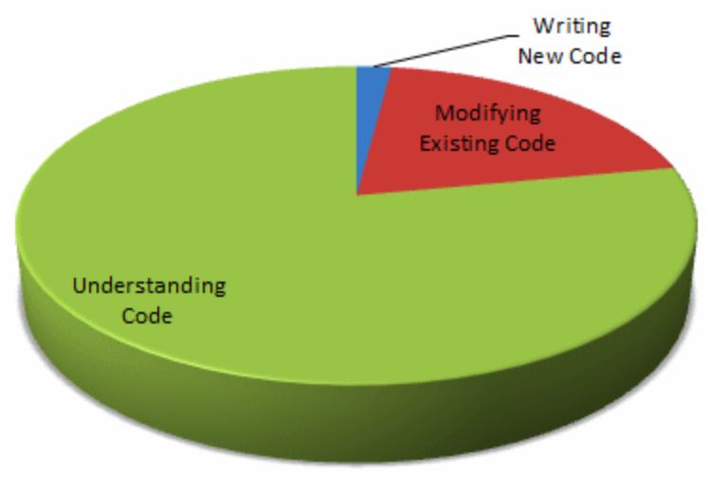
By Jeff Atwood
Notes:
Reference: https://blog.codinghorror.com/when-understanding-means-rewriting/

Slide 87
Bridging the Gap: Engineers and Testers

Slide 88
Not just Unit Tests

Slide 89
More Feedback Tests!

Slide 90
Testing for
Feedback Loop
Help to Write
Unit Tests
Help to Understand
Help to Understand
Help to Understand
Integration
Tests
Help to Change
Help to Change
Help to Change
E2E
Tests

Slide 91
Feedback Testing
and You
Contract Tests
False Positive
False Positive
Flaky Tests
False Negative
Flaky Tests
False Negative

Slide 92
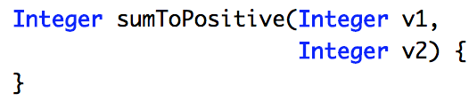
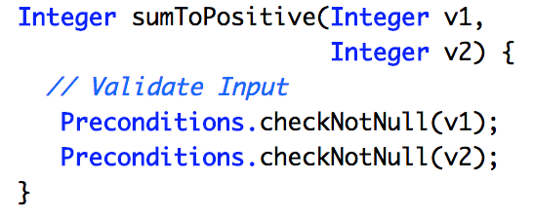
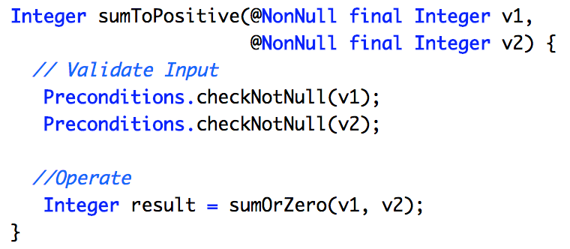
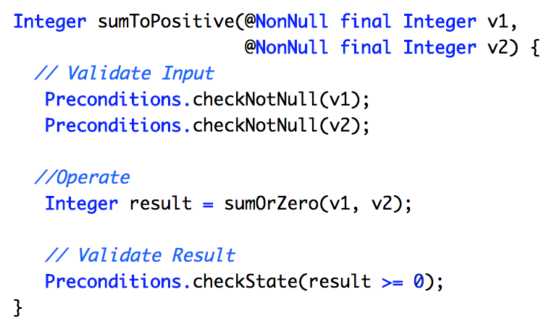
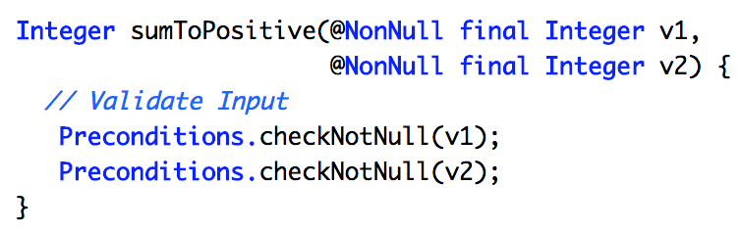
“Require No More,
Promise No Less”
Design by Contract
Design by Contract
Quote from Bertrand Meyer, “Design by Contract”

Slide 93
Contract Testing
Tests as Auditor
Last Day Style
Invariants Testing

Slide 94
Property Based Testing
QuickTheory
Invariants Testing
Schema Based Testing
Schema Based Testing
JSON Schema Validator
JSON Schema Validator
Notes:
Design by Contract

Slide 95
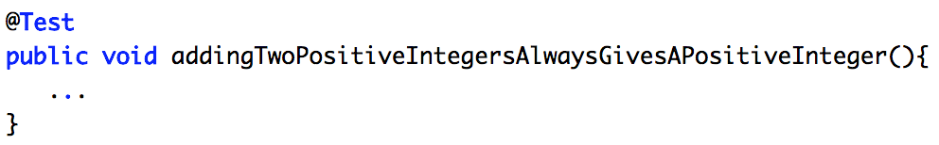
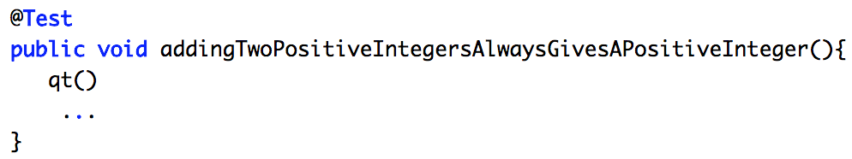
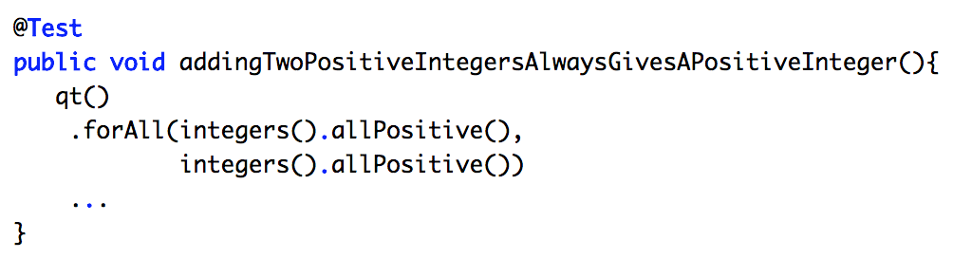
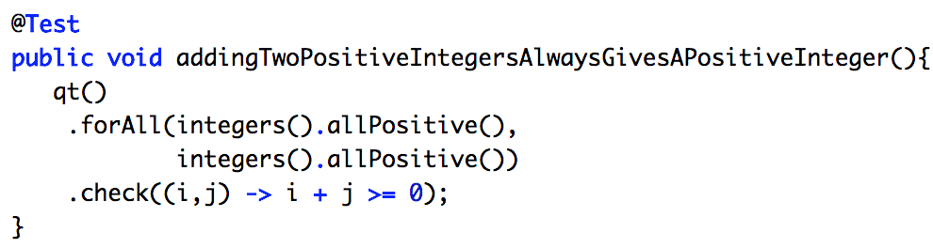
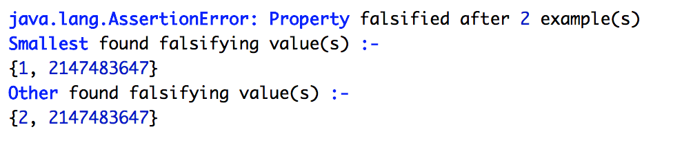
QuickTheory
Notes:
How much money will spend during BlackFriday

Slide 96
Feedback Testing
and You
Contract Tests
Contract Tests
False Positive
False Positive
False Positive
Flaky Tests
Flaky Tests
False Negative
Flaky Tests
False Negative
Notes:
Failures become a routine
Can't see the forest for the trees

Slide 97
Invalid Failures
are Dangerous

Slide 98
“It’s always failing”

Slide 99
“It’s just a flapper”

Slide 100
“Simply environment issues”

Slide 101
You are breaking
the most important thing!

Slide 102
Breaking Trust
Notes:
Trust in your Testing that supposed improve trust in your software

Slide 103
Flaky tests

Slide 104
What do they
remind you of?

Slide 105

Concurrency
is like
Remind anything?
Notes:
We fear what we don`t understand
Reference: Pixabay

Slide 106
Flaky tests
Nondeterministic Tests
Intermittent Tests
Long-Running Tests
Notes:
Categories in your pipeline
Types
Ndt
even with the same input, can exhibit different behaviors on different runs
Int
occuring at irregular intervals; not continuous or steady
Long running
Recognize limits
more actions means more risk

Slide 107
Again

Slide 108
Trust is very important!

Slide 109
How do we build Trust?

Slide 110
Dealing with Flaky Tests
Categorize
Reproduce
Fix
Remove
Notes:
Already done that
Make sure to store data setup/data on a failure
Attempt to fix but timebox
Feel free to remove - calcucate ROI

Slide 111

Talk Suggestion
Notes:
Reference: https://www.youtube.com/watch?v=XnkWkrbzMh0

Slide 112
Feedback Testing
and You
Contract Tests
Contract Tests
False Positive
False Positive
False Positive
False Positive
Flaky Tests
Flaky Tests
Flaky Tests
False Negative
Flaky Tests
False Negative
False Negative

Slide 113

Notes:
Reference: https://www.pexels.com/photo/people-sign-traveling-blur-2069/

Slide 114
False Negatives:
Mutation Testing
Jester
NinjaTurtles
Manual
Notes:
Java
C#
Manual

Slide 115
By Tim Cochran
Notes:
Reference: https://medium.com/@timothy.cochran/test-pyramid-the-key-to-good-automated-test-strategy-9f3d7e3c02d5

Slide 116
Real “Test Pyramids”
Ice Cream Cone
Ice Cream Cone
Hourglass
Hourglass
Hourglass
Cupcake
Cupcake

Slide 117
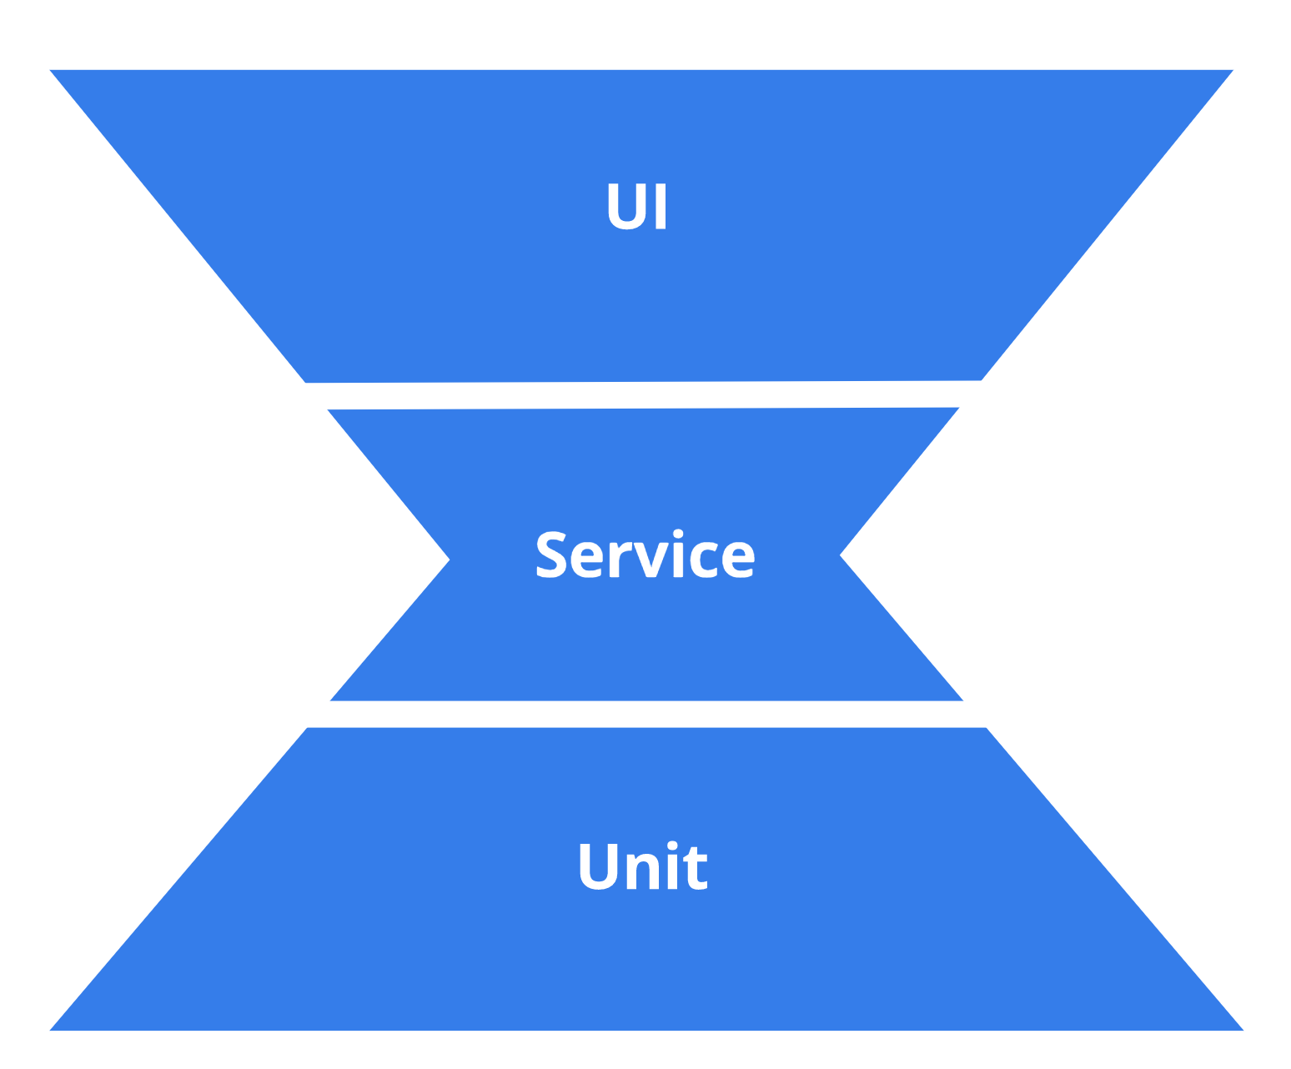
By Tim Cochran
Notes:
Reasons:
TDD with same old practices of lots of UI tests
Reference: https://medium.com/@timothy.cochran/test-pyramid-the-key-to-good-automated-test-strategy-9f3d7e3c02d5

Slide 118
Problem?

Slide 119
Communication

Slide 120
Real “Test Pyramids”
Ice Cream Cone
Ice Cream Cone
Hourglass
Hourglass
Hourglass
Hourglass
Cupcake
Cupcake
Cupcake

Slide 121
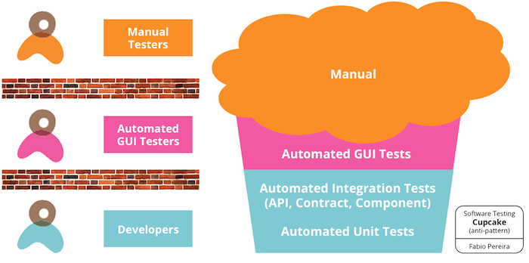
By Fabio Pereira
Notes:
Reasons:
Everybody is involved but still duplication
Reference: https://www.thoughtworks.com/insights/blog/introducing-software-testing-cupcake-anti-pattern

Slide 122
Problem?

Slide 123
Communication

Slide 124
Noticing a pattern?

Slide 125
Communication
is the Key!

Slide 126
Agenda
Quality vs. Quantity
Quality vs Quantity
Back to Basics
Back to Basics
Back to Basics
Back to Basics
Team Dynamics
Team Dynamics
Team Dynamics

Slide 127
Communication
Goal Alignment
↓ Direction of Pyramid
Same Language
Hybrid
Teams
Notes:
Everyone understands what they are trying to build - best customer experience
Not Hunger Games
Everyone should keep moving to the lower layers
Ubiquitous Language
Naming production and test classes
Cross-Functional Teams
Encourage Training (LogiGear example)

Slide 128

Notes:
South Korea in 1980s and 1990s
From book, Outliers, by Malcolm Gladwell
Afraid to speak up
Changed to English and got better
Reaching Understanding
Reference: https://www.pexels.com/photo/jet-cloud-landing-aircraft-46148/

Slide 129
Team Understanding
Testing/
Production
Team Ownership
United Team
Customer is Key
Notes:
Test=Production code
Everyone is responsible
Everyone is equal
Customer is the goal

Slide 130
Call For Action
Welcome Change
Respect Basics
Lead by Example
Communicate!

Slide 131
Q/A

Slide 132
About Speaker
Twitter: @DmitryVinnik
LinkedIn: in/dmitry-vinnik/
Email: dmitry@dvinnik.com

